Slide 1




AttScan
PROJECT X:
Automated Attendance
System
IT-3C: TEAM A

Slide 2




AttScan
Presentation Outline
Introduction
Objective
Scope
Application Demo
Admin
Instructor
Student

Slide 3
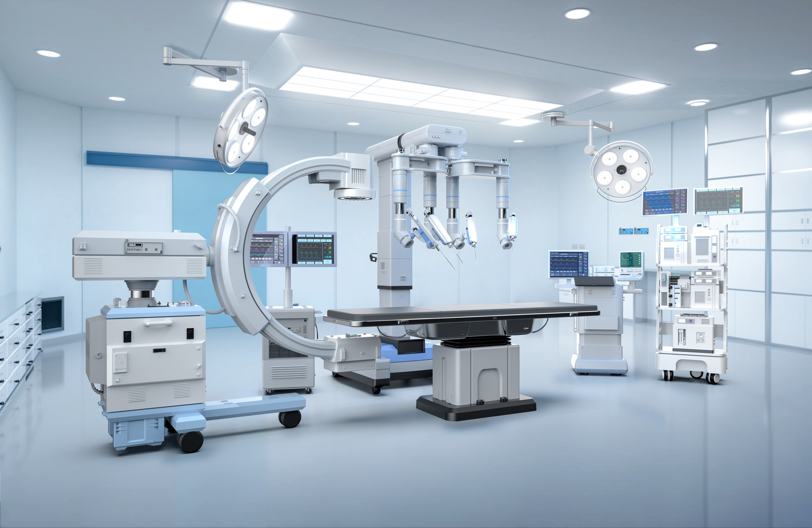
AttScan
Introduction
AttScan is a mobile-based Automated Attendance System (AAS) created to make attendance checking faster, easier, and more secure. It uses modern tools like QR code scanning, GPS location tracking, and One-Time Password (OTP) verification to make sure that each attendance record is real and correct.

Slide 4
AttScan
Introduction
With AttScan, schools can avoid the problems of manual attendance, reduce cheating, and save time. This system helps create a more honest and organized learning environment by using simple but powerful technology.

Slide 5


AttScan
Objectives
The development of AttScan aims to provide an efficient, secure, and reliable solution for automating student attendance in educational institutions. Specifically, the app seeks to:
Capture real-time and accurate student data, including full name, student ID, course, schedule, and location, ensuring authenticity during the attendance session.

Slide 6
AttScan
Objectives
Record student attendance automatically by tracking QR codes, GPS location, and OTP verification, eliminating the need for manual entry.
Allow students to view their attendance records for transparency and accountability.
Generate comprehensive, time-stamped attendance reports that can be accessed by instructors and administrators for analysis.

Slide 7



AttScan
Scope
The AttScan system is specifically designed for educational environments, where courses, students, and instructors are predefined and managed by an administrator.
Students are able to log in to the system using their credentials but cannot sign up, as account creation is managed and controlled by administrators.

Slide 8
AttScan
Scope
The system uses QR code scanning, GPS location tracking, and One-Time Password (OTP) verification for authentication and attendance recording, eliminating the need for manual attendance-taking.
AttScan does not support biometric scanning (e.g., facial recognition or fingerprints), focusing on the combination of these technologies for user verification and accurate attendance tracking.

Slide 9

AttScan
Application Demo
Admin
The Admin is responsible for overall system management and maintenance. This includes registering and managing accounts for both instructors and students, and ensuring that only authorized devices are used within the system. The Admin also has access to all attendance reports and user data for monitoring and administrative purposes.

Slide 10
AttScan
Application Demo
Instructor
The Instructor is responsible for overseeing attendance in the classes they are assigned to. They use AttScan to initiate and monitor attendance sessions, verify student presence using QR scanning, Current Locations, and view detailed attendance reports.

Slide 11
AttScan
Application Demo
Student
The Student uses AttScan to securely log their attendance during scheduled sessions. Students can view their own attendance records through the mobile app, which promotes transparency and accountability. Students cannot register or modify their accounts, as these are created and managed by the Admin.

Slide 12

AttScan
Thank you!!
IT-3C: TEAM A

